Slide 1


Discovering regulatory switches in gene co-expression networks
Luca Farinola, Ramón Reszat, Patrick Mertens, Alaric de Biolley
Notes:
[Alaric]
explain agenda for our presentation
Data mining group MAGnet miners
exploring co-expression networks

Slide 2
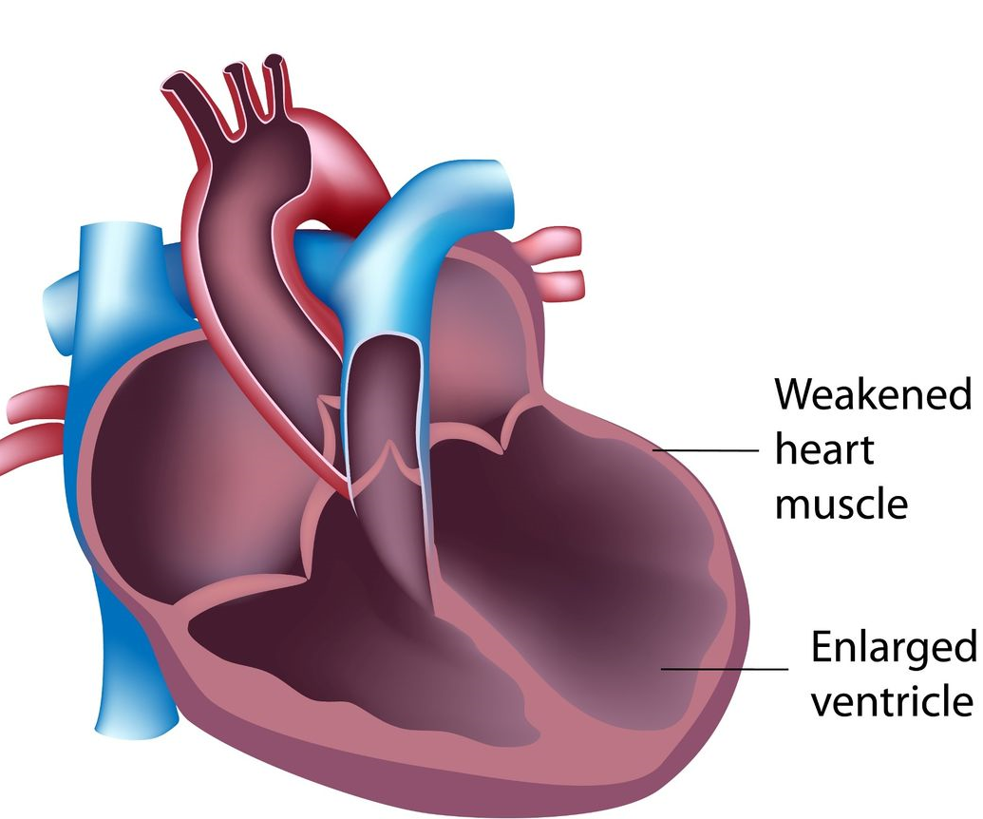

Switch Genes in Dilated Cardiomyopathy
HYPOTHESES
Select regulatory genes
(SWIMMER)
Switch genes hold regulatory roles in key pathways associated with dilated cardiomyopathy.
Viral induced cardiomyopathy (VCM) can be identified among non-healthy patients
Investigate biological processes (WikiPathways)
Analyze potential viral cause of dilated cardiomyopathy
1
Notes:
[Alaric]
The aims for our project were to focus on the regulatory aspects of gene expression data in cardiomyopathy
1st aim: identify key genes that have the property of switching on or off clusters of other genes
2nd aim viral causes of cardiomyopathy because strong influence on gene expression is a confounding factors
3rd linking our results with existing literature and curated databases Wikipathways
We hypothesize that specific genes could have a role in transitioning from a healthy to a disease phenotype
Choose to focus on dilated cardiomyopathy as the underlying mechanisms are less than for cardiac hypertrophy
Variety of different cause from exposure to toxins or infections and inflammation
Enlargement and dilation of one or both ventricles
Reduced contractility
Increase the chance of developing heart failure

Slide 3
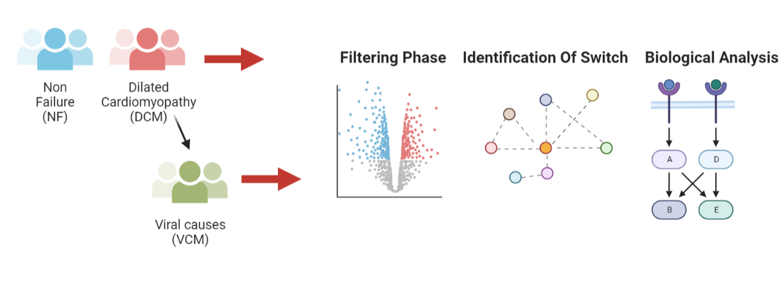
Study Design
2
Notes:
[Alaric]

Slide 4
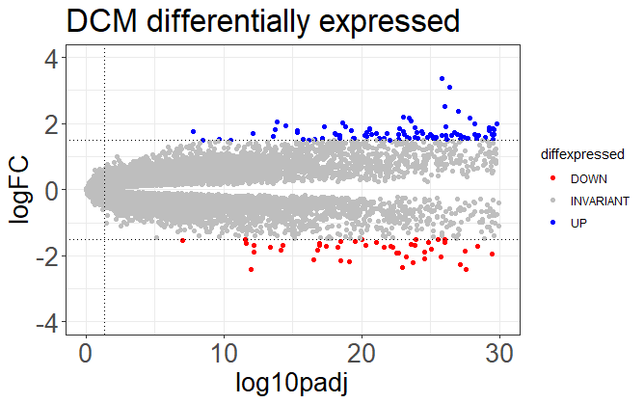

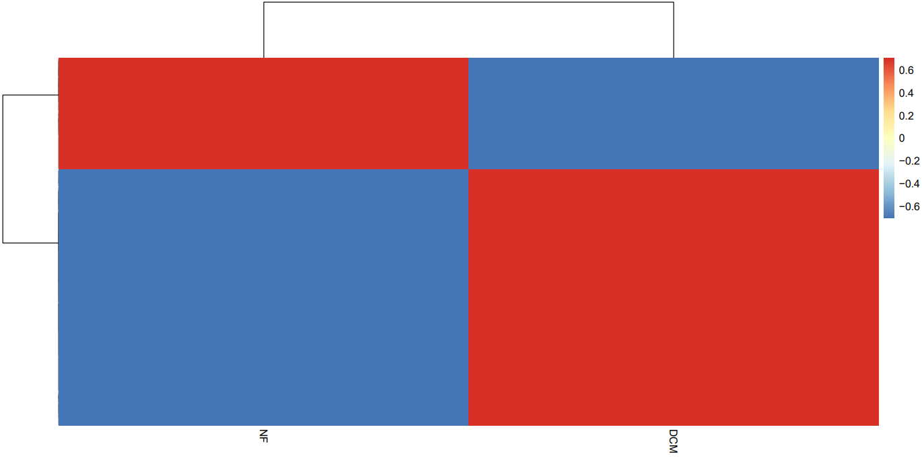
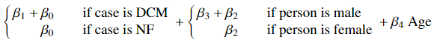
Gene expression analysis
Legend
Differentially expressed obtained through multivariate linear regression
Slope coefficient correct for : Age and Gender
Differentially expressed genes selected for their
Significance ( p-value lower than 0.05)
Change in expression (| logFC | > 1.5)
Logarithmic Fold Change
Up regulated
Down regulated
-log(adjusted p-value)
NF
DCM
3
Notes:
[Alaric]
2084531 -> red #d02d1f
2323245 -> blue #1717f5

Slide 5

Network Analysis

Slide 6
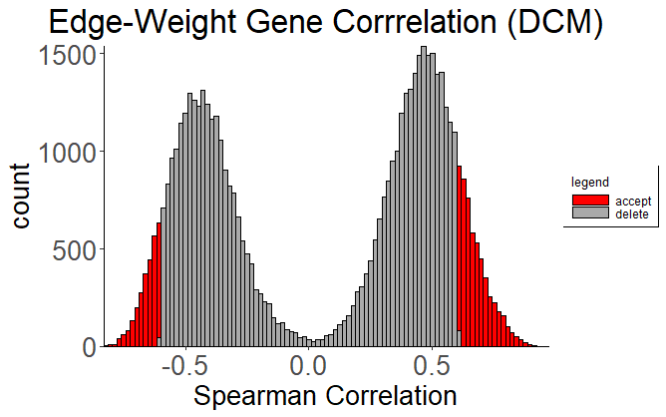
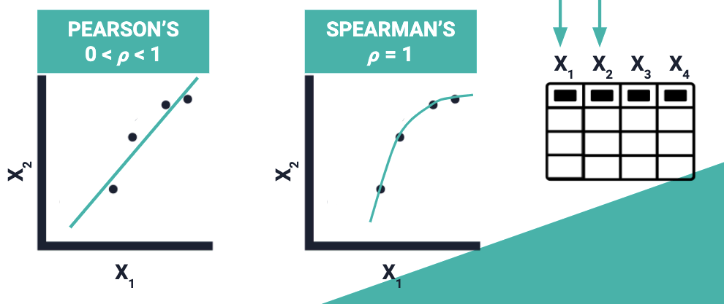
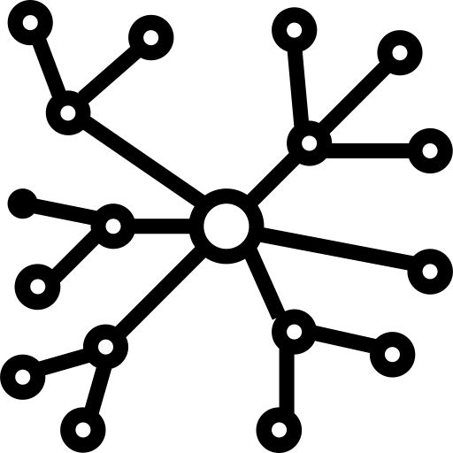
Network Construction
Weighted correlation networks to visualize gene co-expression
Spearman correlation is chosen for nonlinear monotonic relationships
Image : source
4
Notes:
[Luca]

Slide 7
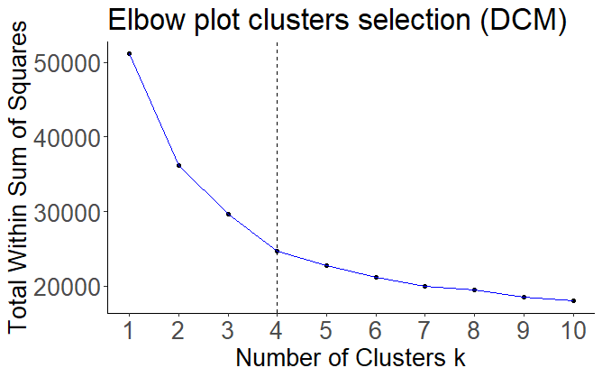
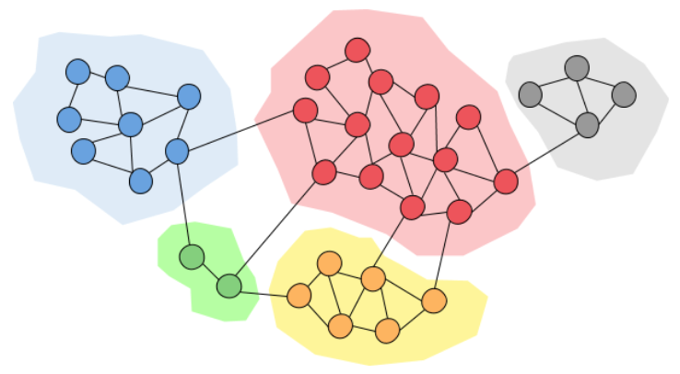
Finding Communities
Elbow plot used to establish the optimal number of clusters
Clustering algorithms used to find communities
5
Notes:
[Luca]

Slide 8
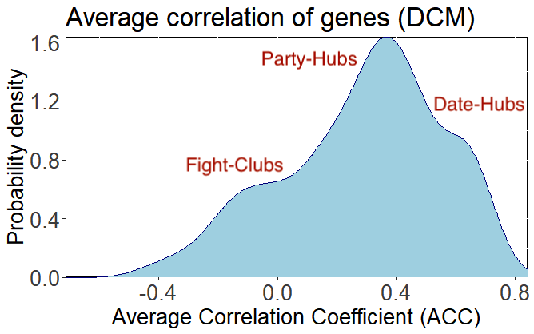
Fight Clubs
Party-Hubs
Hubs positively correlated
Hubs strongly positively correlated
Date-Hubs
Fight-Clubs
Hubs negatively correlated
6
Notes:
[Luca]

Slide 9

Fight Clubs
Party-Hubs
Hubs positively correlated
Hubs strongly positively correlated
Date-Hubs
Fight-Clubs
Hubs negatively correlated
7
Notes:
[Luca]

Slide 10

What are switch genes?
High participation coefficient P
Switch genes highly interact with genes outside of their own cluster
Low within-module degree z
Switch genes poorly interact with genes inside their own cluster
Switch genes are anti-correlated with their partners
Negative average correlation
8
Notes:
[Ramón]
We are looking for nodes with certain characteristics in the gene co-expression network
1st High participation coefficient: calculated by …
2nd low within-module degree puts the node on the periphery of a cluster

Slide 11
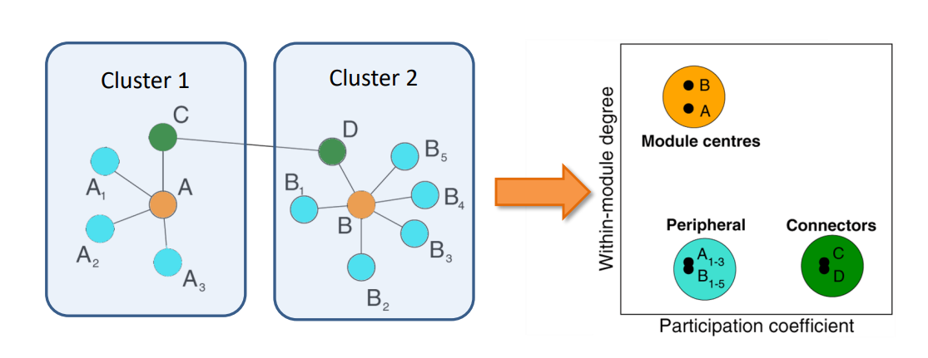
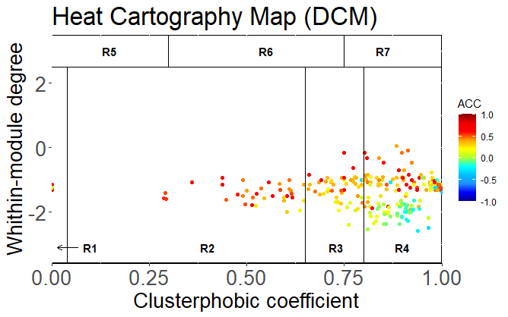
Amaral Guimerà Cartography
Nature 2005, 433, 895-900
8
Notes:
[Ramón]

Slide 12
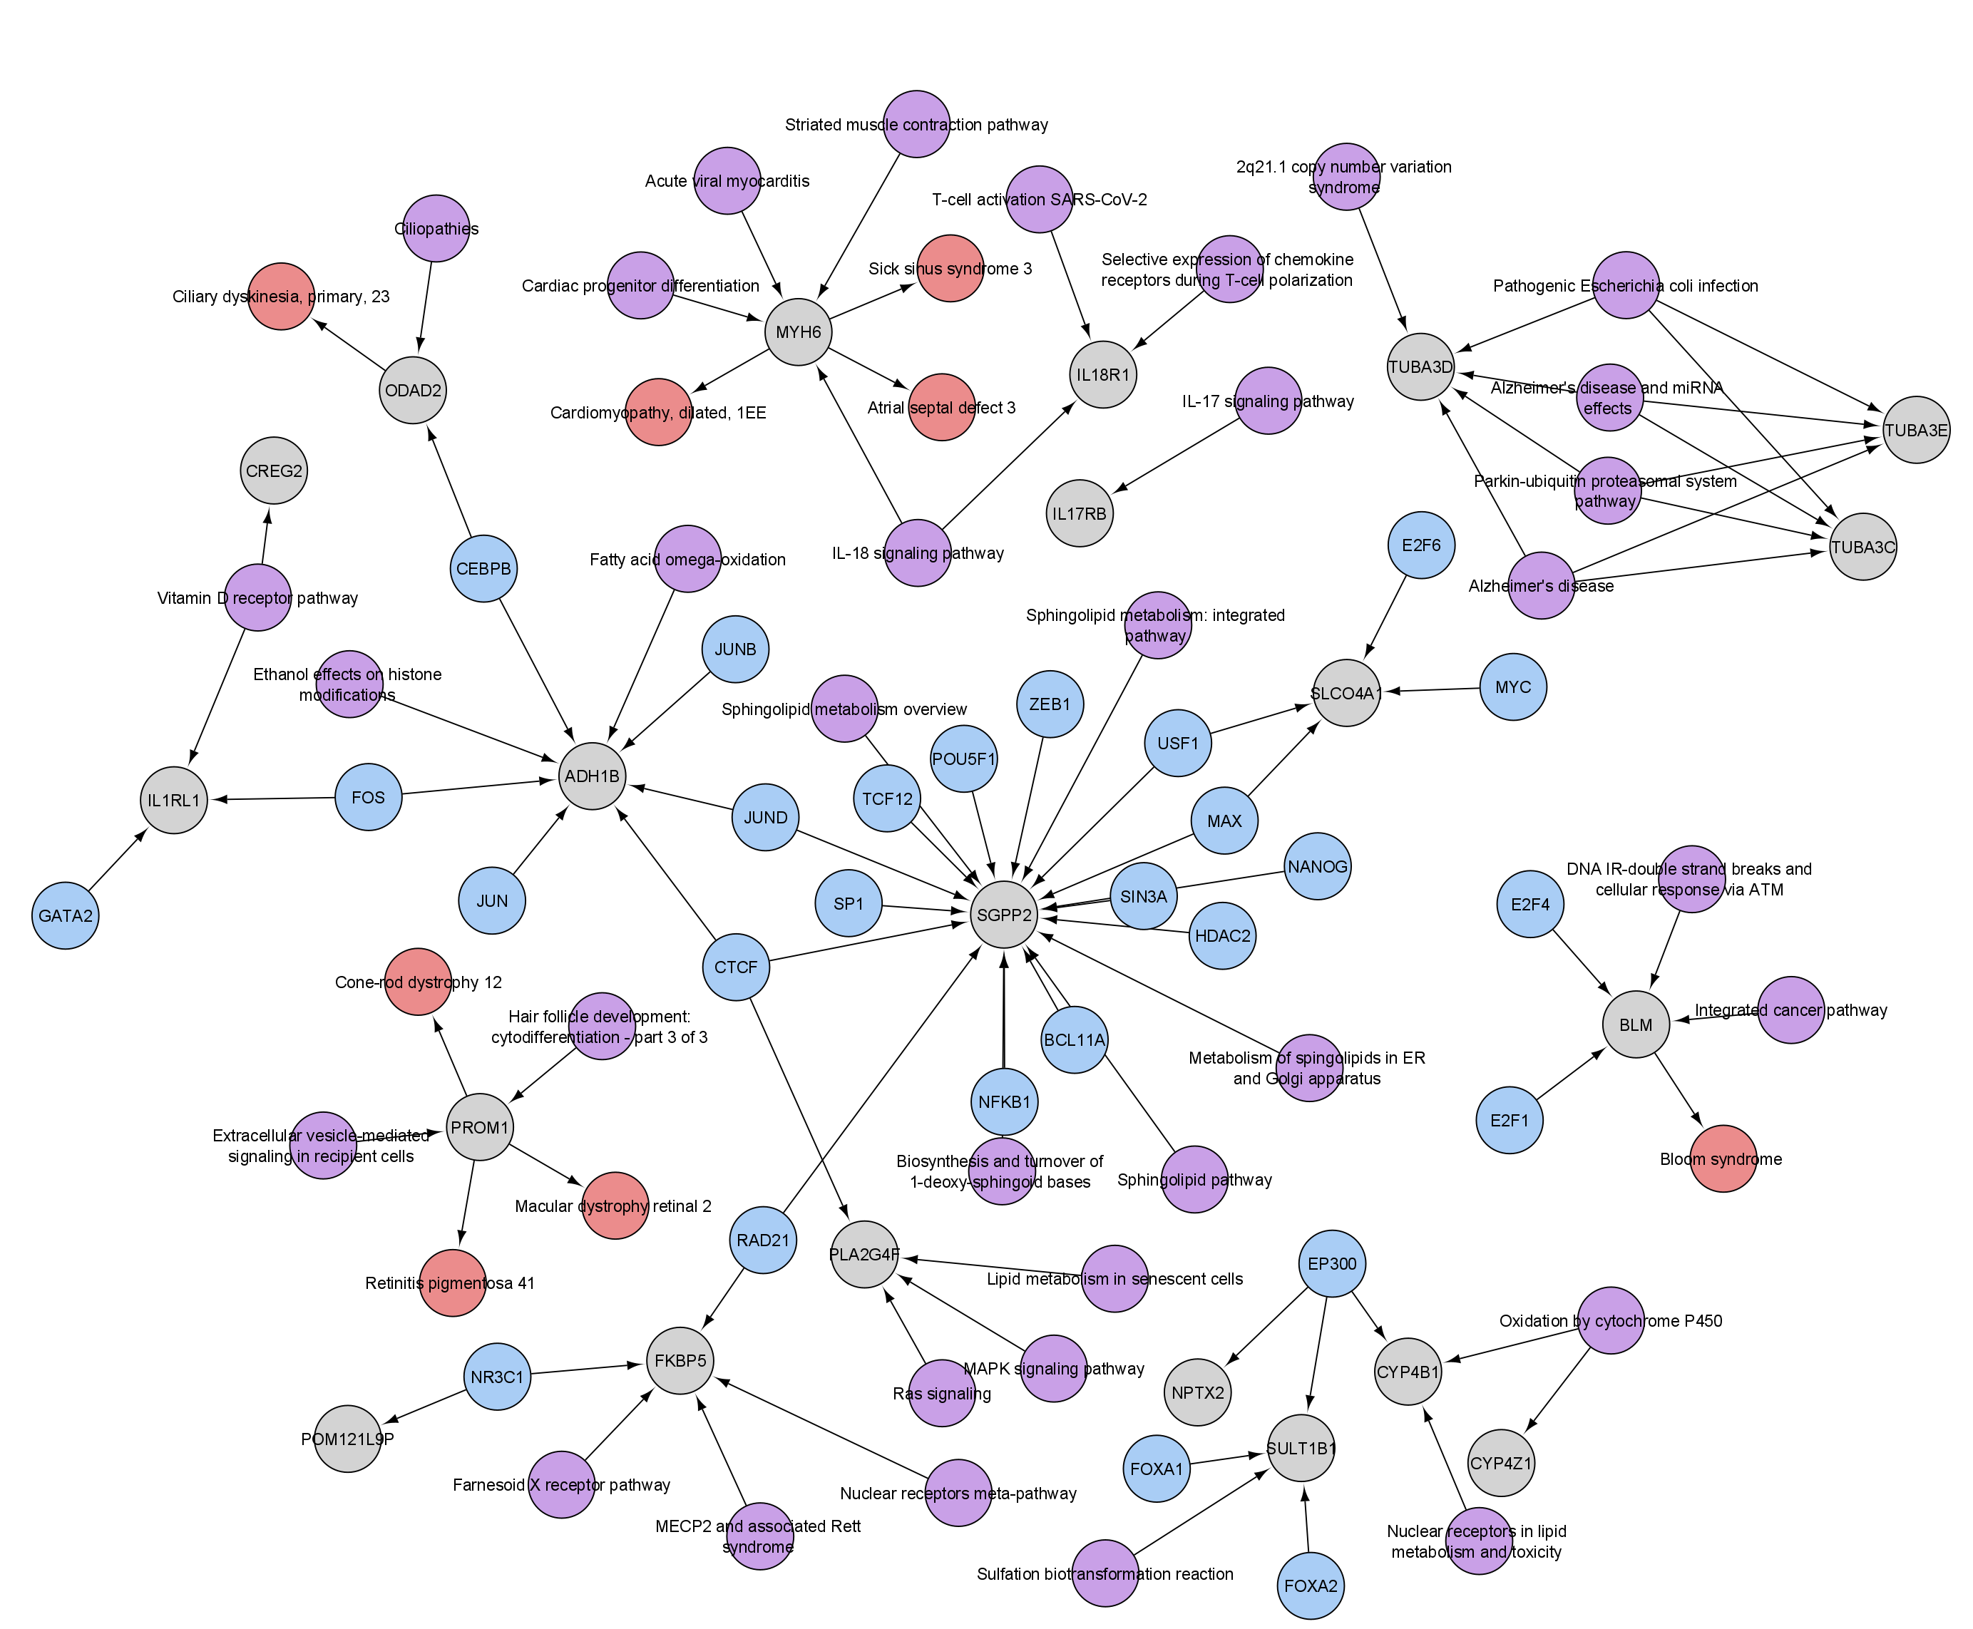

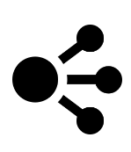


Switch Genes Results
Legend
Switch Genes
Encode
WikiPathways
Disease
10
Notes:
[Ramón]

Slide 13

Viral Causes
Notes:
[Patrick]

Slide 14
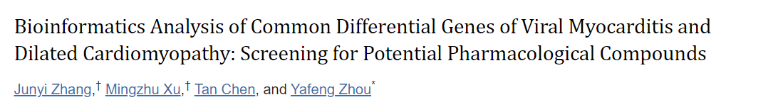
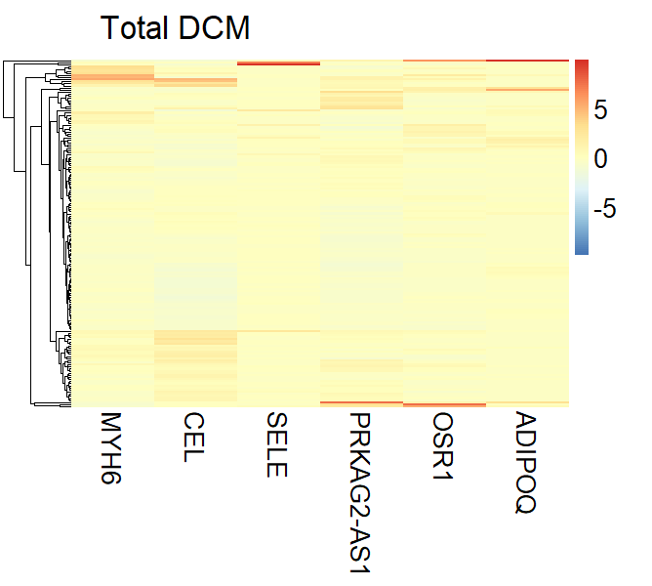
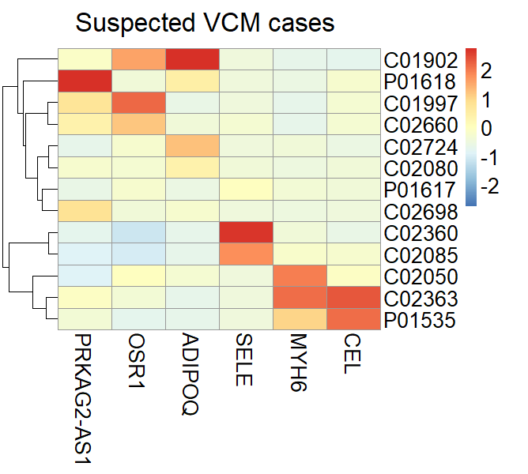
Possible VCM causes ?
11
Notes:
[Patrick]

Slide 15
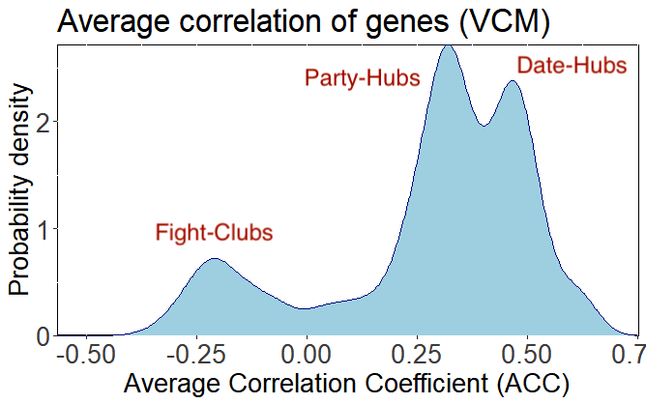
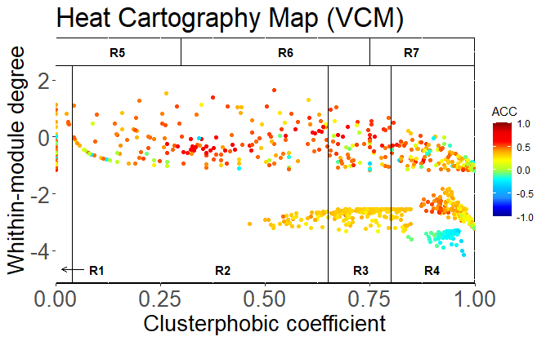
Switch Genes in Viral Cardiomyopathy
12
Notes:
[Patrick]

Slide 16
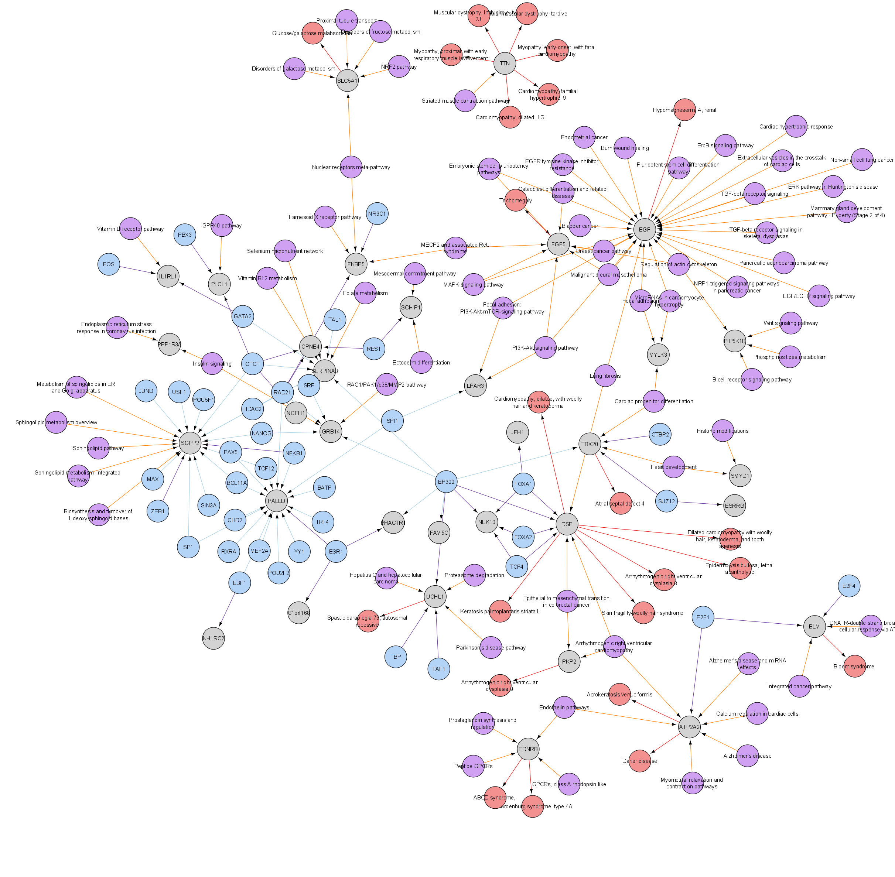
Switch Genes Results
Legend
Switch Genes
Encode
WikiPathways
Disease
13

Slide 17
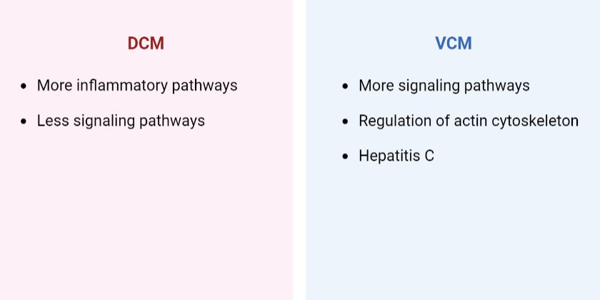
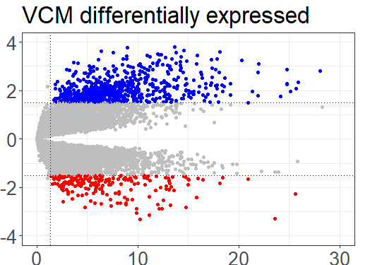
Difference between DCM and VCM results
14

Slide 18
Q&A
Thank you for your attention! We’re looking forward to an interesting round of discussion.
Switch genes
Dilated cardiomyopathy
Co-expression networks
Viral causes
Notes:
What about the sample size in VCM, isn’t it too small? What would we do if we had more time and resources available?

Slide 19
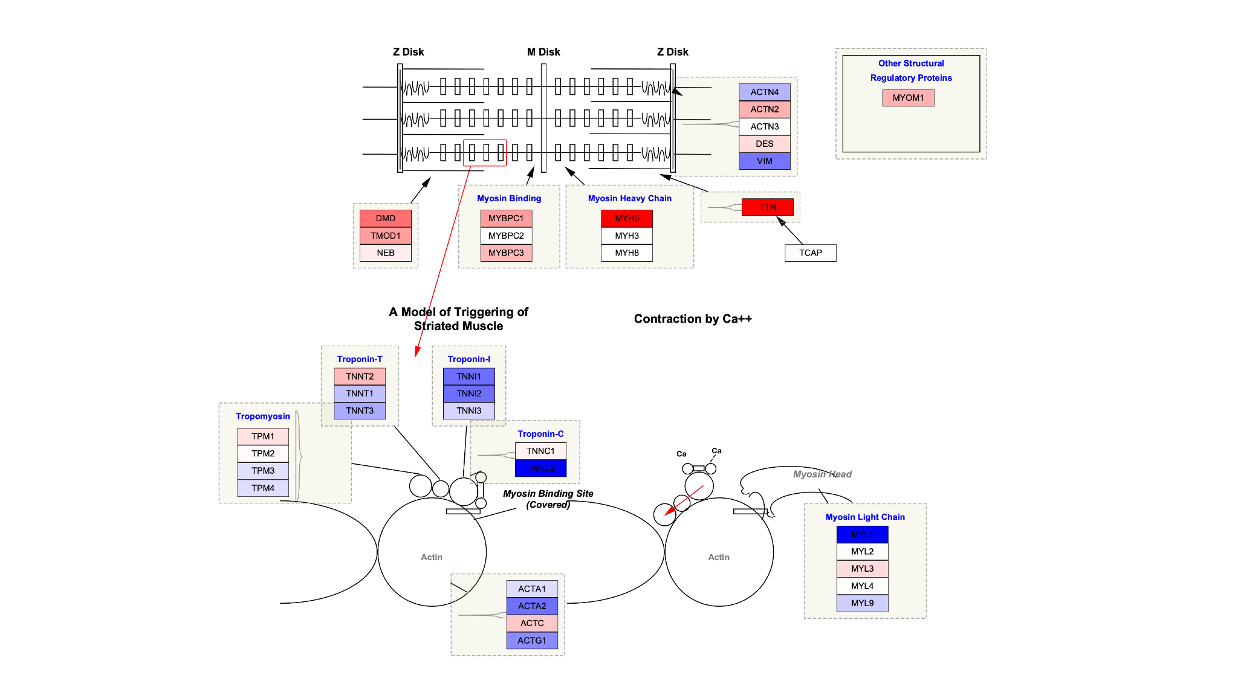
MYH6: Striated Muscle Contraction Pathway
Notes:
[DONE]

Slide 20
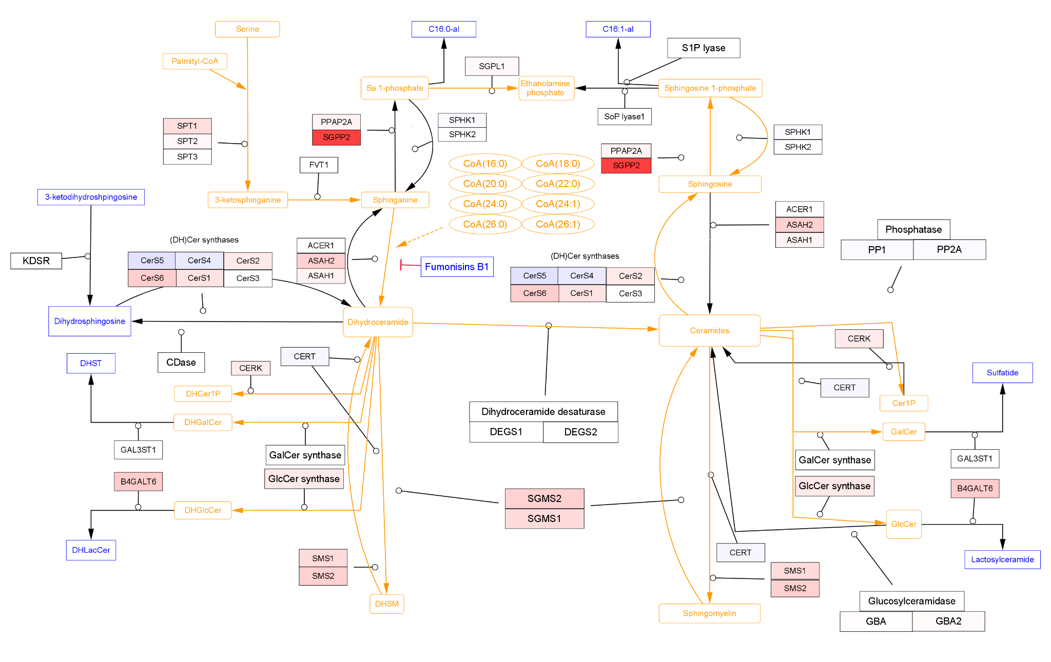
SGPP2: Sphingolipid Metabolism
Notes:
[DONE]

Slide 21
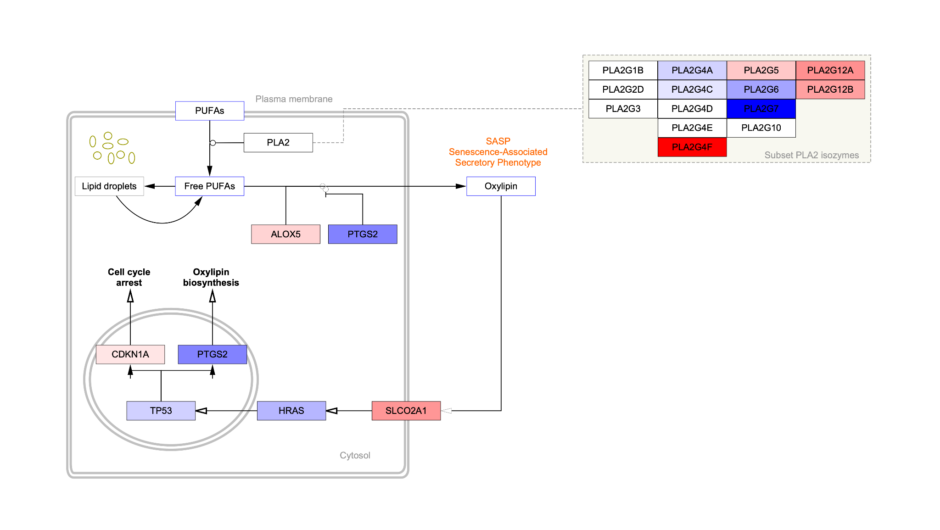
PLA2G4F: Lipid Metabolism in Senescent Cells
Notes:
[DONE]

Slide 22
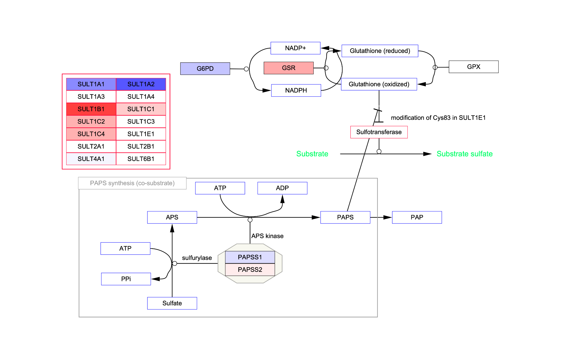
SULT1B1: Sulfanation Biotranformation Reaction
Notes:
[DONE]

